Slide 1
Analyzing the Impact of Car Features on Price and Profitability
-final project-3

Slide 2
PROJECT DESCRIPTION:
The project is all about analyzing car data and drawing meaningful insights from it. The performance and market value of a car, as defined by its specifications, price, and customer preferences, are crucial for the automobile industry.
Understanding factors such as engine specifications, fuel efficiency, brand reputation, market demand, and pricing trends can provide valuable insights for better decision-making in car sales and manufacturing.
The project data is given in an Excel sheet, which should be cleaned and made ready for analysis.

Slide 3
TECH STACK USED:
SOFTWARE: MICROSOFT 365 WEB:
I used microsoft 365 web(EXCEL) online website to perform the excel operations.As the excel app is paid platform,I have used the online free site.It had all the operations of new version of excel(2021).
OPERATING SYSTEM: MacOS
My device is MacOs.I have used it as it is stable and efficient.

Slide 4
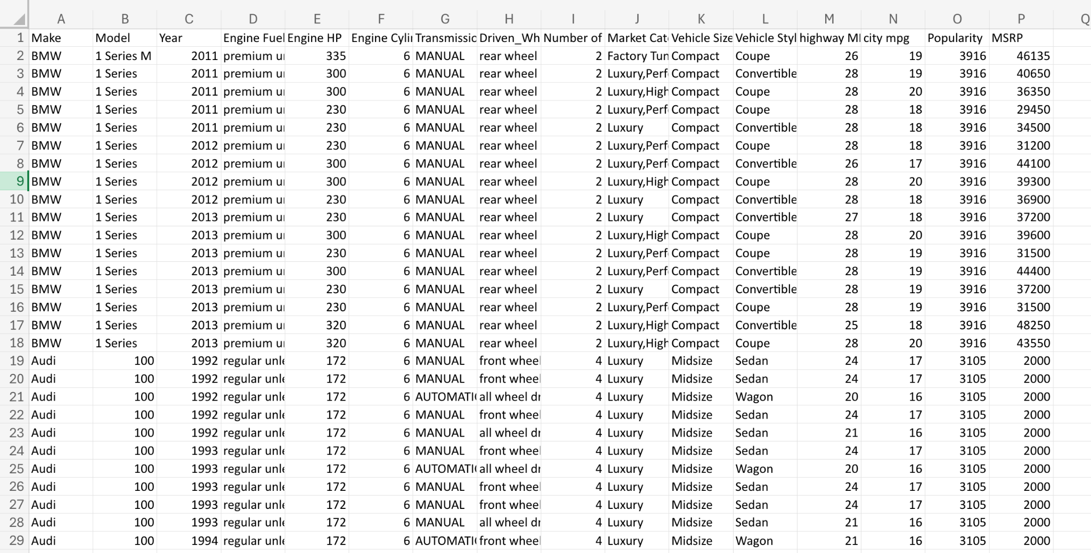
RAW DATA:
The given dataset has 16 columns and 11,915 records

Slide 5
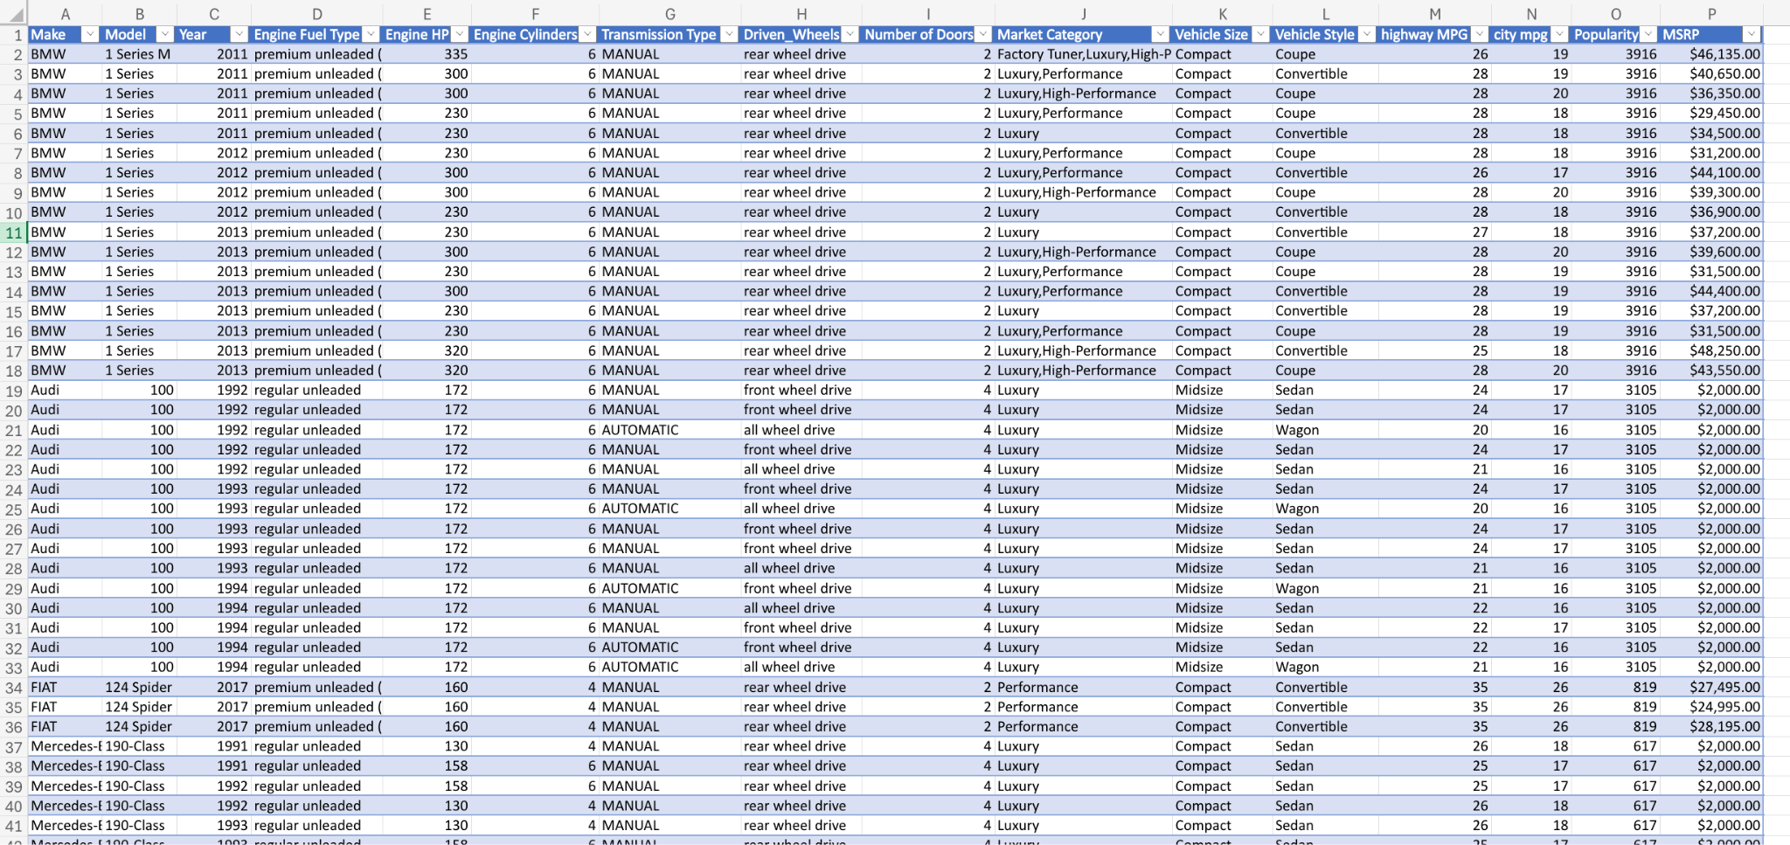
DATA Cleaning:
I created a table with given data.
By using filters I checked blanks in the dataset.Then,I deleted all the records which have blanks in them to increase the consistency of data.
The final dataset has 11,813 records.

Slide 6
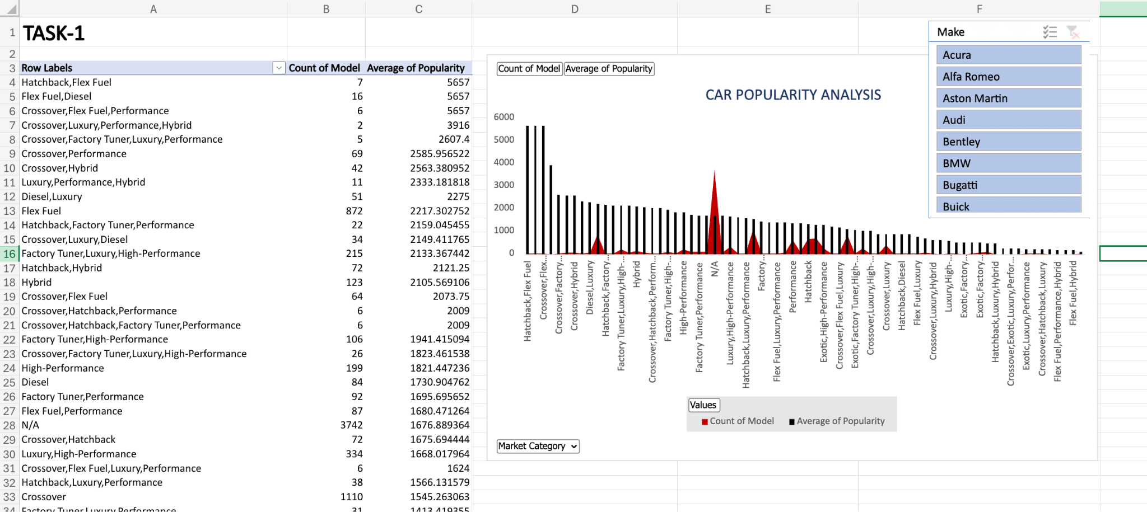
DATA ANALYTIC TASKS:
1.Insight Required: How does the popularity of a car model vary across different market categories?
Task 1.A: Create a pivot table that shows the number of car models in each market category and their corresponding popularity scores.
Task 1.B: Create a combo chart that visualizes the relationship between market category and popularity.

Slide 7
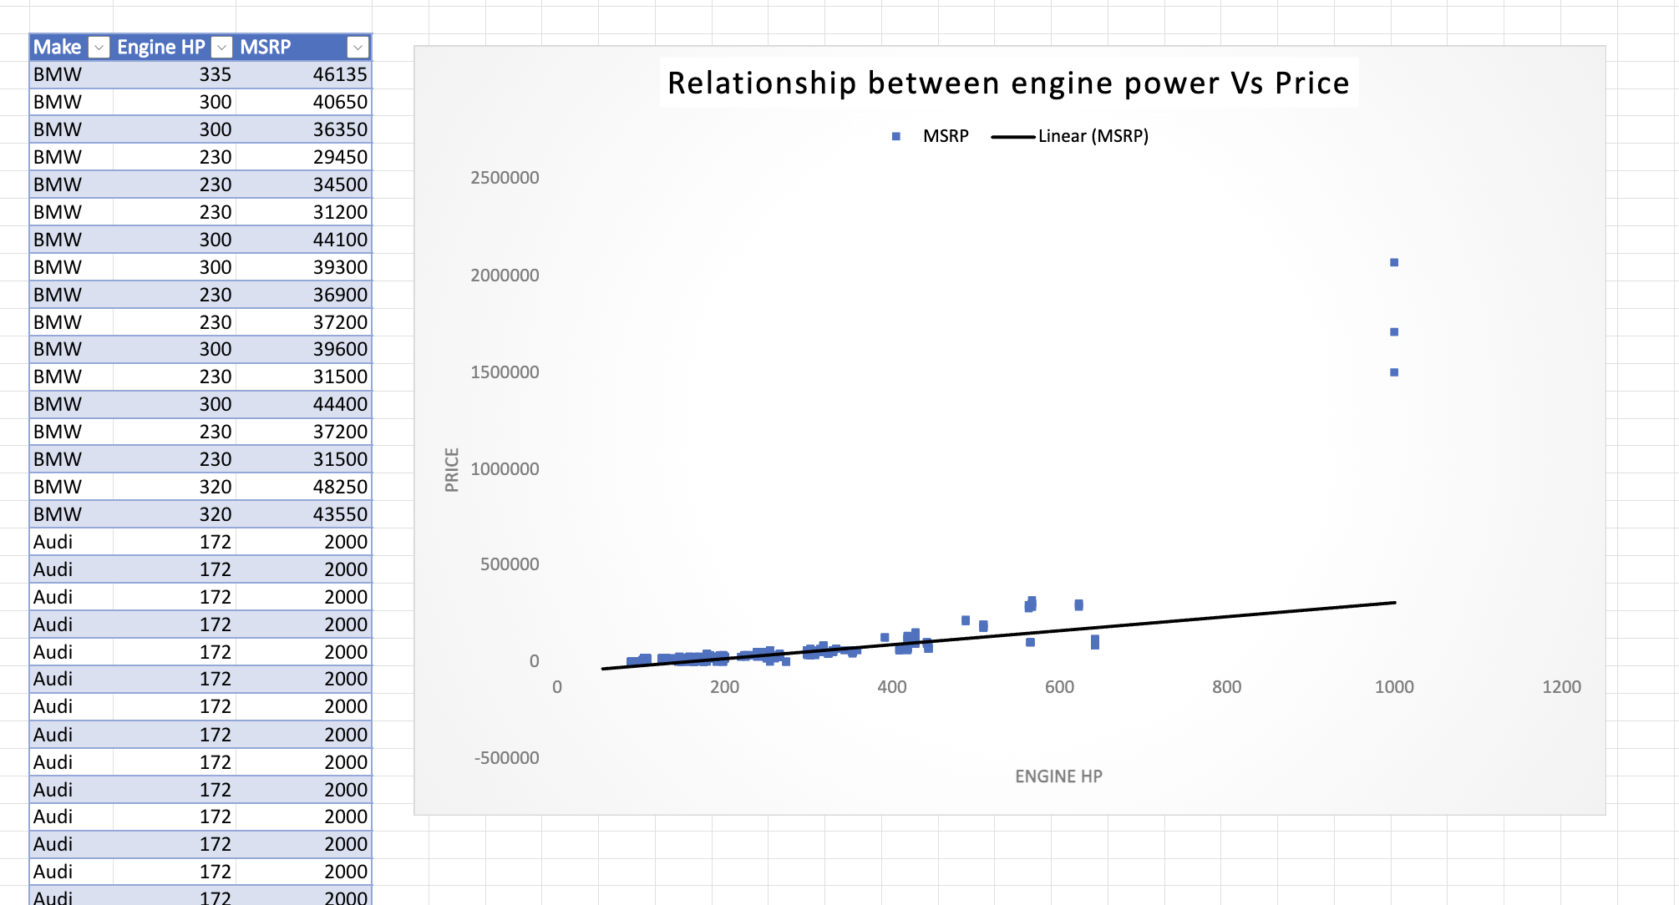
DATA ANALYTIC TASKS:
2.Insight Required: What is the relationship between a car's engine power and its price?
Task 2: Create a scatter chart that plots engine power on the x-axis and price on the y-axis. Add a trendline to the chart to visualize the relationship between these variables.

Slide 8
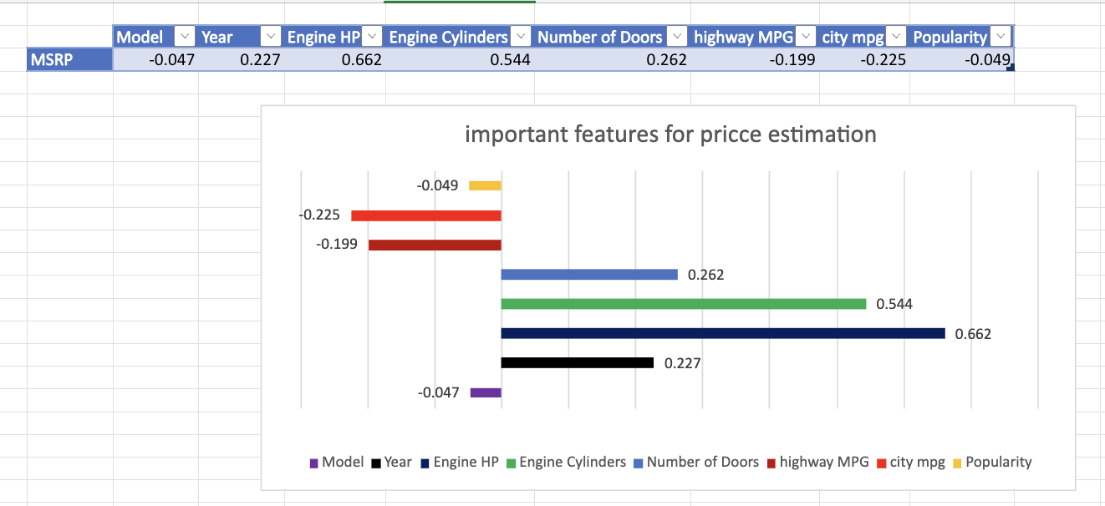
DATA ANALYTIC TASKS:
3.Insight Required: Which car features are most important in determining a car's price?
Task 3: Use regression analysis to identify the variables that have the strongest relationship with a car's price. Then create a bar chart that shows the coefficient values for each variable to visualize their relative importance.

Slide 9
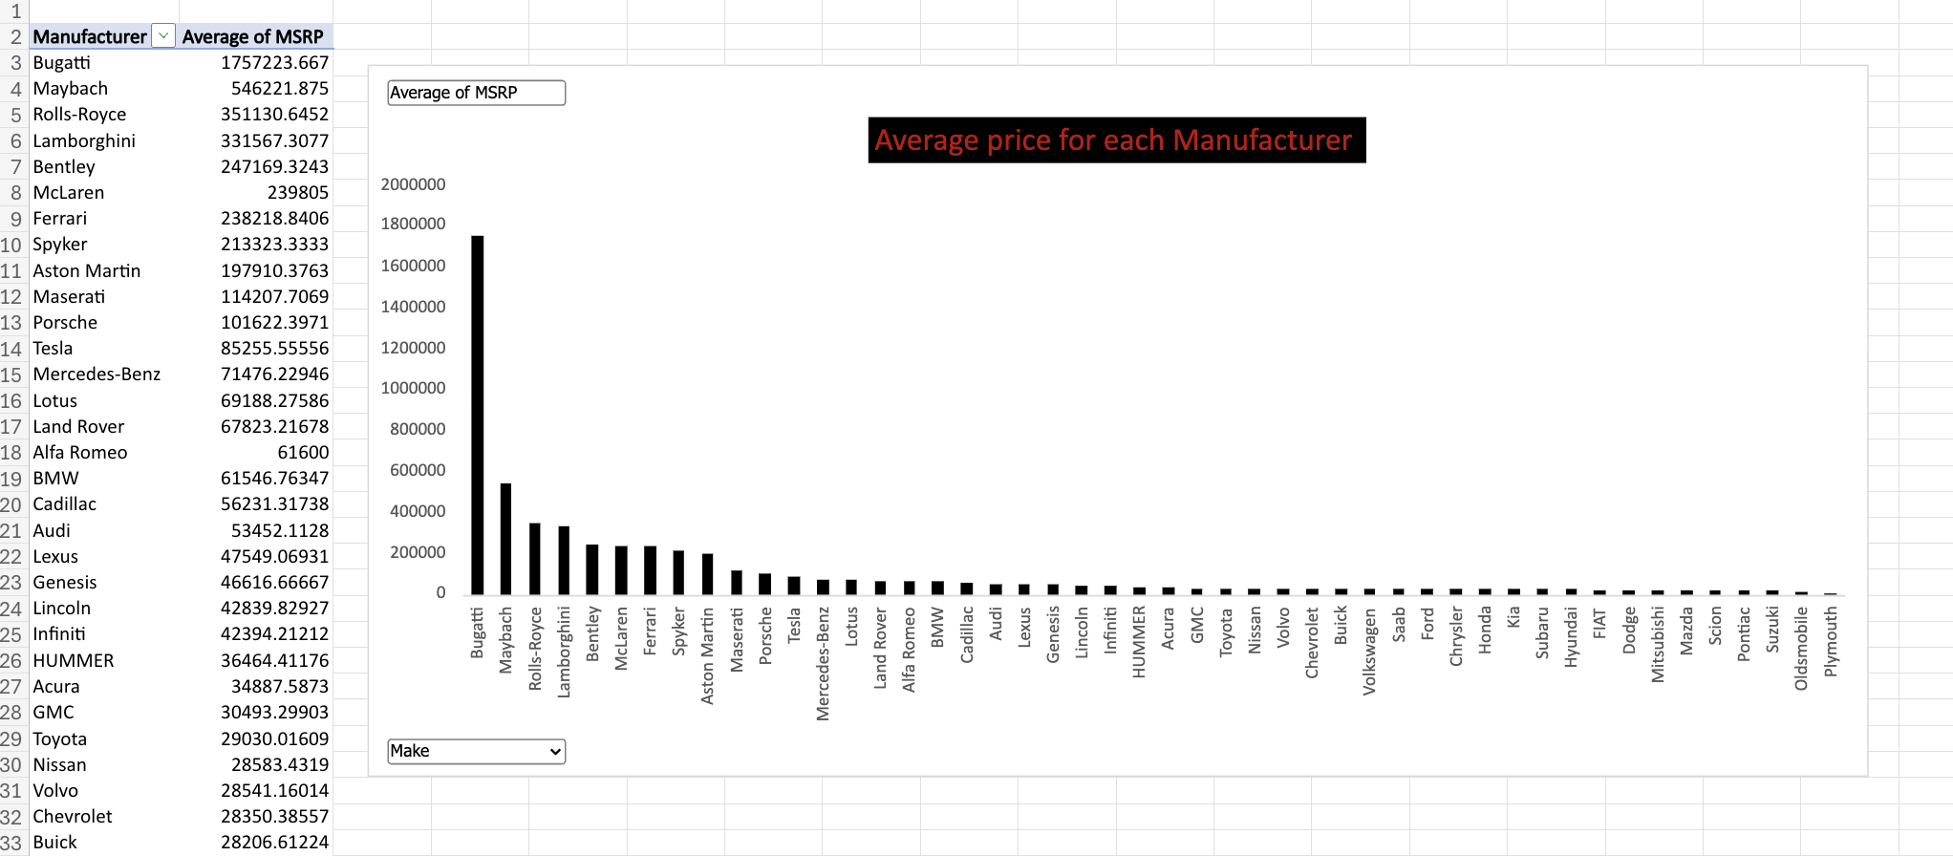
DATA ANALYTIC TASKS:
4.Insight Required: How does the average price of a car vary across different manufacturers?
Task 4.A: Create a pivot table that shows the average price of cars for each manufacturer.
Task 4.B: Create a bar chart or a horizontal stacked bar chart that visualizes the relationship between manufacturer and average price.

Slide 10
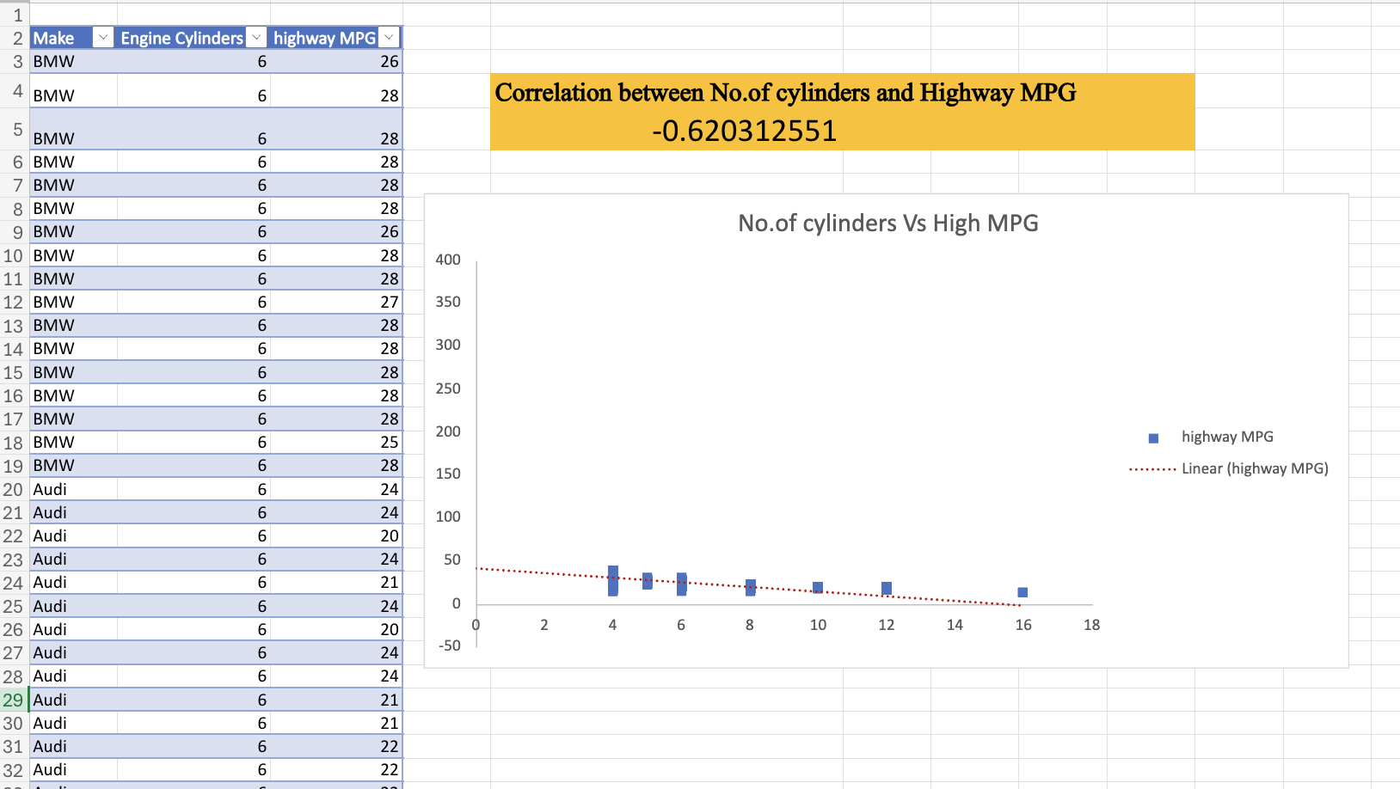
DATA ANALYTIC TASKS:
5.Insight Required: What is the relationship between fuel efficiency and the number of cylinders in a car's engine?
Task 5.A: Create a scatter plot with the number of cylinders on the x-axis and highway MPG on the y-axis. Then create a trendline on the scatter plot to visually estimate the slope of the relationship and assess its significance.
Task 5.B: Calculate the correlation coefficient between the number of cylinders and highway MPG to quantify the strength and direction of the relationship.

Slide 11
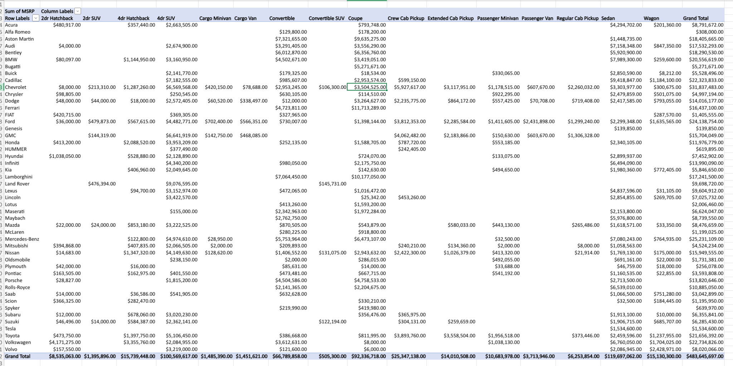
Building the Dashboard:
Task 1: How does the distribution of car prices vary by brand and body style?

Slide 12
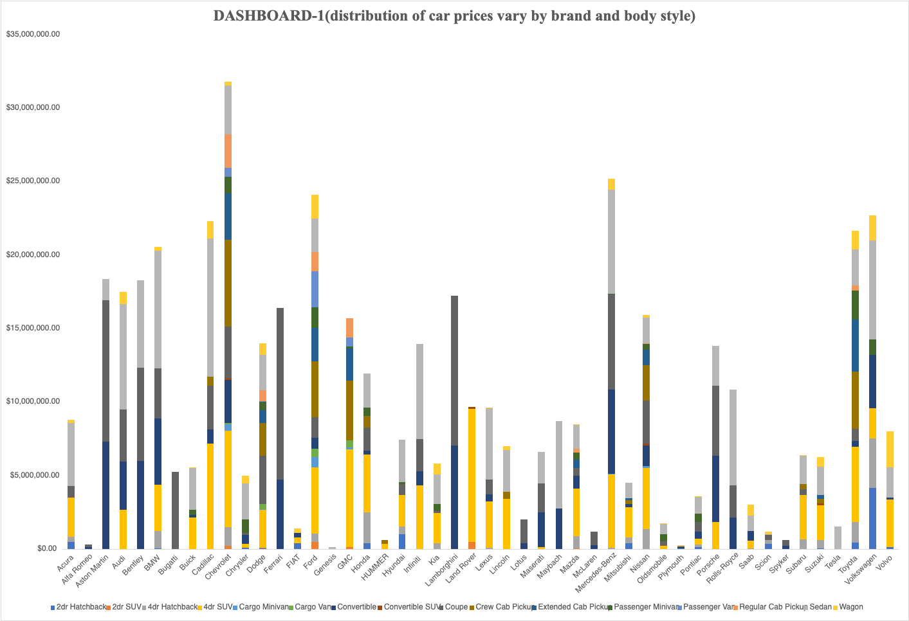
Building the Dashboard:
Task 1: How does the distribution of car prices vary by brand and body style?

Slide 13
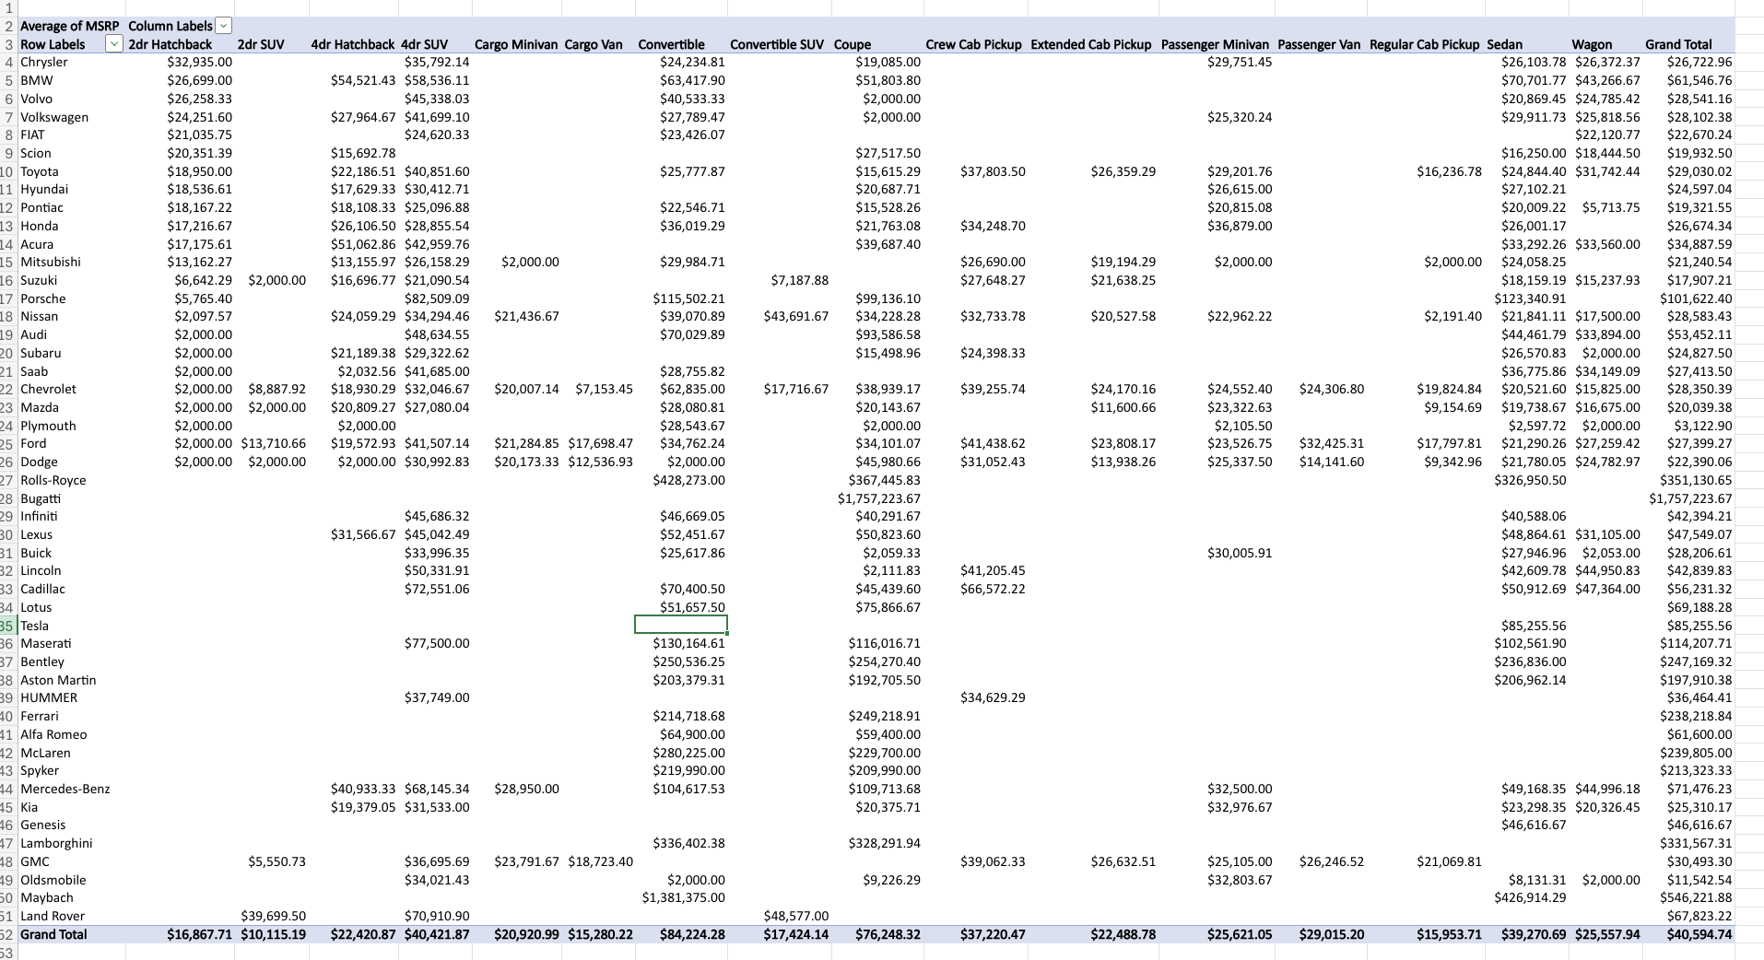
Building the Dashboard:
Task 2: Which car brands have the highest and lowest average MSRPs, and how does this vary by body style?

Slide 14
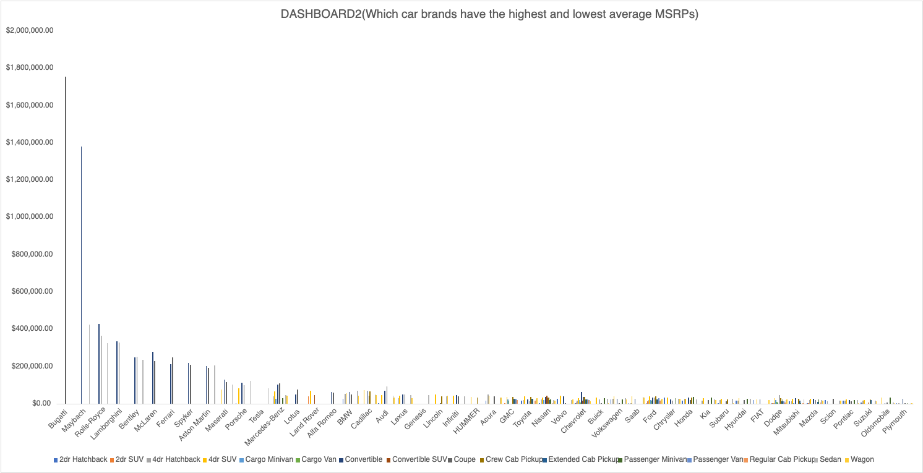
Building the Dashboard:
Task 2: Which car brands have the highest and lowest average MSRPs, and how does this vary by body style?

Slide 15
Building the Dashboard:
Task 3: How do the different feature such as transmission type affect the MSRP, and how does this vary by body style?

Slide 16
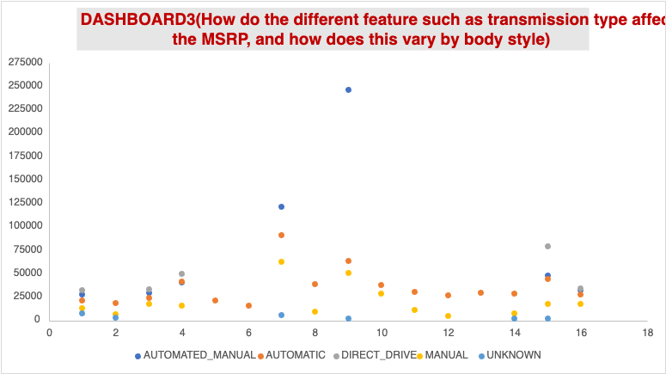
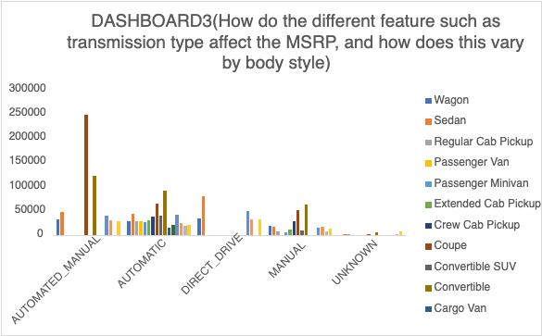
Building the Dashboard:
Task 3: How do the different feature such as transmission type affect the MSRP, and how does this vary by body style?

Slide 17
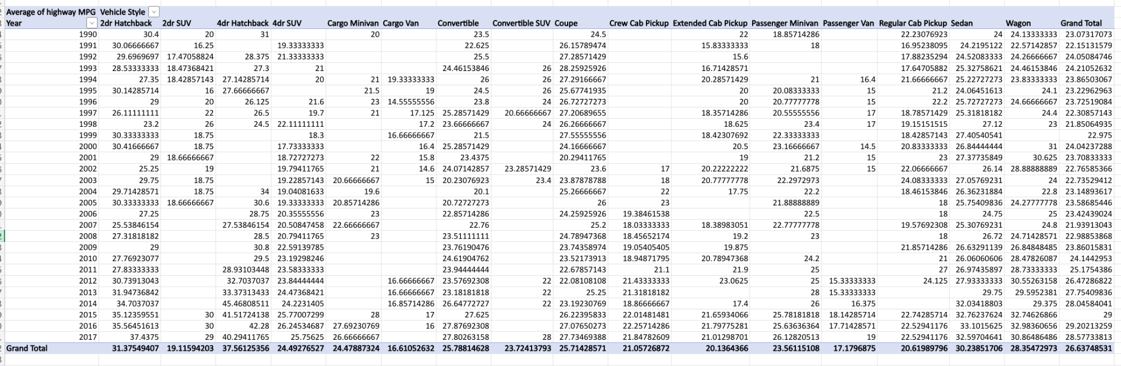
Building the Dashboard:
Task 4: How does the fuel efficiency of cars vary across different body styles and model years?

Slide 18
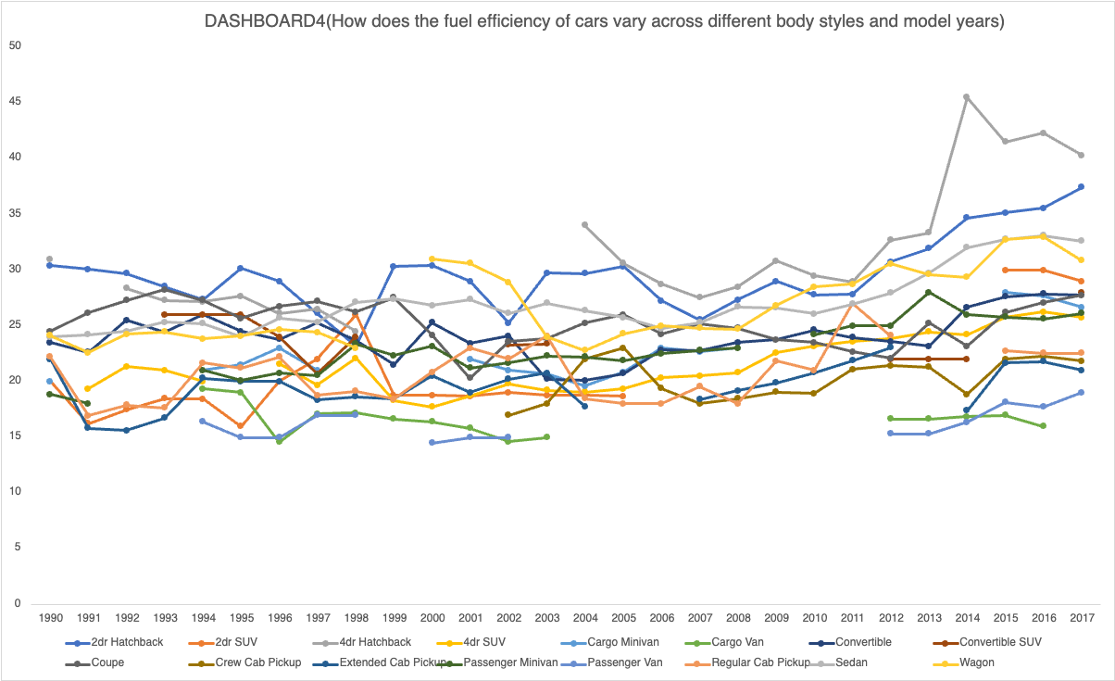
Building the Dashboard:
Task 4: How does the fuel efficiency of cars vary across different body styles and model years?

Slide 19
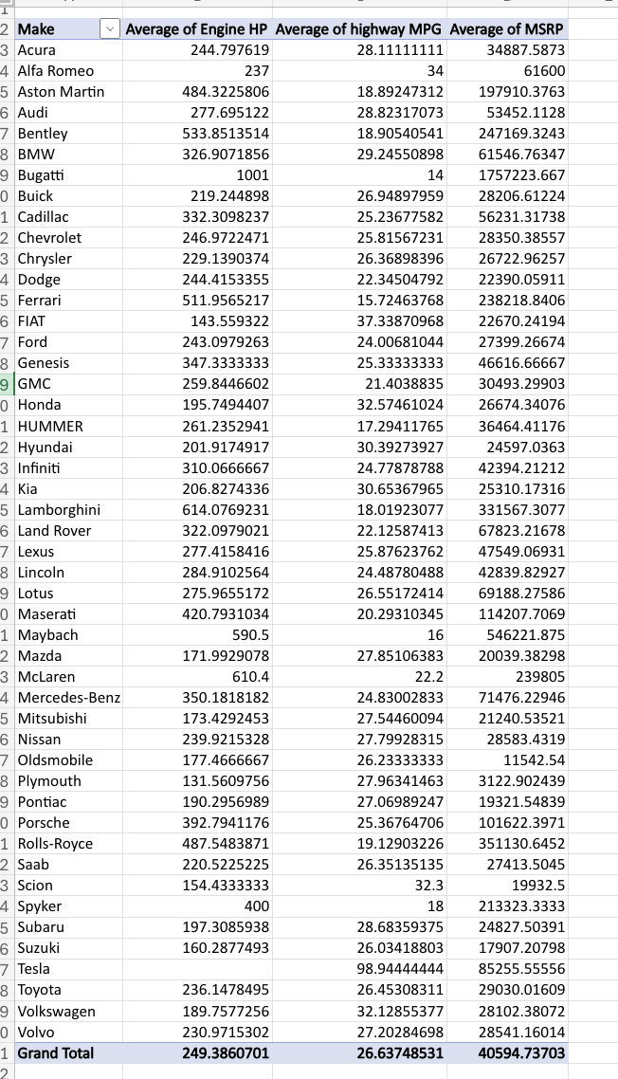
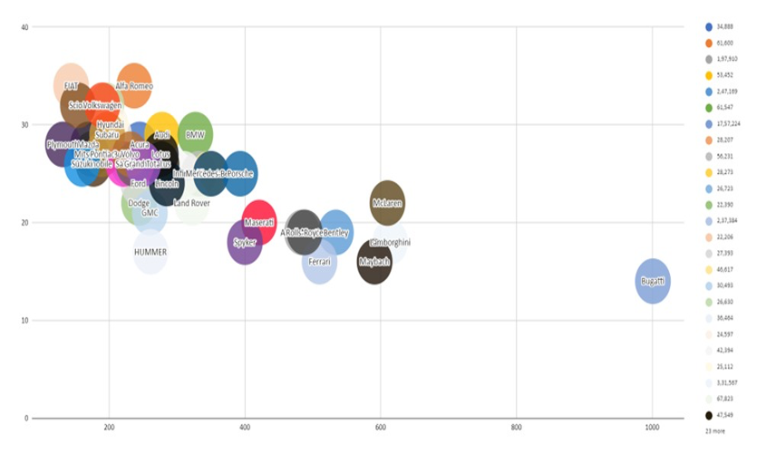
Building the Dashboard:
Task 5: How does the car's horsepower, MPG, and price vary across different Brands?

Slide 20
INSIGHTS:
A. Car Popularity Analysis: Looked at how popular different car models are across various market categories. This helped in understanding which types of cars attract the most consumer interest.
B. Engine Power vs. Price Analysis: Explored how a car’s horsepower affects its price. By using scatter plots and trendlines, we identified whether more powerful cars tend to be more expensive.
C. Feature Importance in Pricing: Analyzed which car features play the biggest role in determining a car’s price. Regression analysis was used to find out which aspects, like fuel type or transmission, impact pricing the most.
D. Manufacturer Pricing Analysis: Compared the average prices of cars from different manufacturers to see which brands position themselves as affordable, mid-range, or luxury.
E. Fuel Efficiency vs. Engine Cylinders Analysis: Studied how the number of cylinders in a car's engine affects its fuel efficiency. This helped in understanding the trade-off between power and mileage.
F. Interactive Dashboard Development: Built an Excel dashboard that makes it easy to explore insights using filters and charts. This allows users to interact with the data and see how different features impact car pricing and popularity.

Slide 21
RESULT:
By the project, I have analyzed car feature and pricing data, including engine power, fuel efficiency, market category, and brand.
I identified how each factor influences car popularity, pricing, and profitability.
This project had a good impact on understanding consumer preferences, pricing strategies, and key features that drive market demand.

Slide 22
REFERENCE LINK:
The link for excel sheet file:
EXCEL_FILE

Slide 23
THANK YOU

